Slide 1

Trending YouTube
Video Statistics
By:
Fereshte Bagheri
Ali Zamani
Soroush Esfahanian

Slide 2
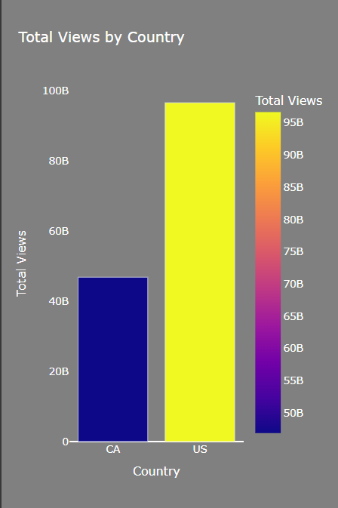
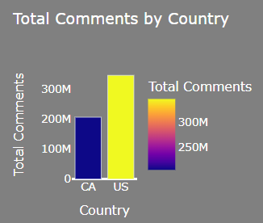
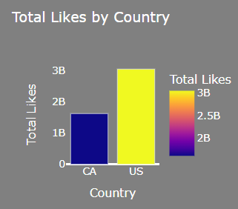
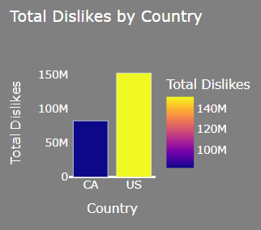
Country
------------
------------
CA
US
40881 trending videos from
2008-01-13 to
2018-06-14
------------
40949 trending videos from
2006-07-23 to 2018-06-14
------------

Slide 3
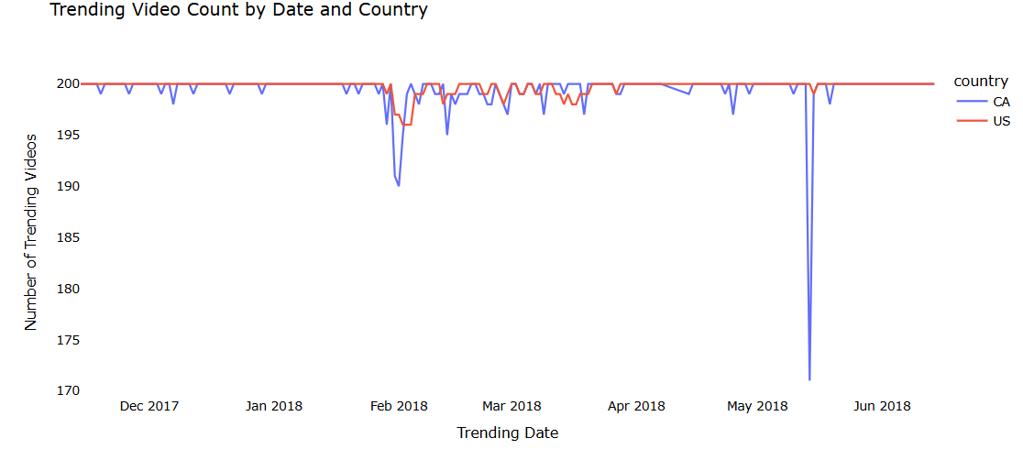

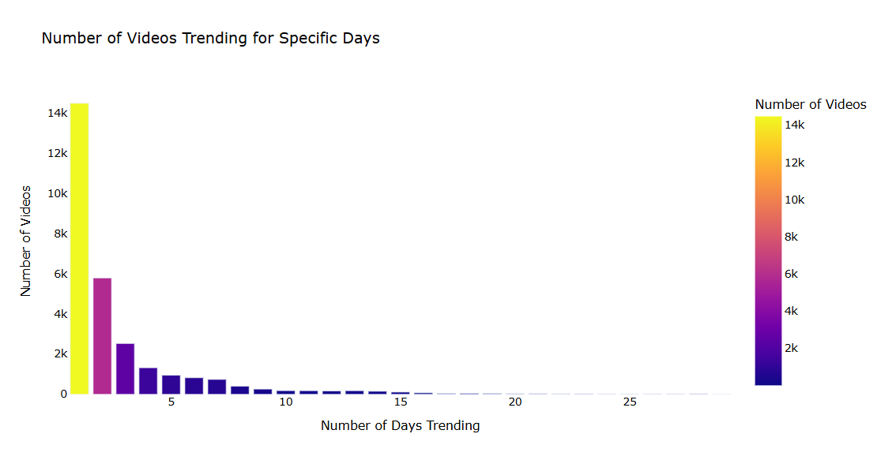
Country
Video Id,
Trending Date
------------
------------
------------
------------
The most trending period in the dataset was 29 days, with 126 videos from popular channels such as SamSmithWorldVEVO, Lucas and Marcus, Unbox Therapy, and Selena Gomez trending during this period.
------------
------------
@Smosh
@Smosh
@Smosh
@Smosh

Slide 4
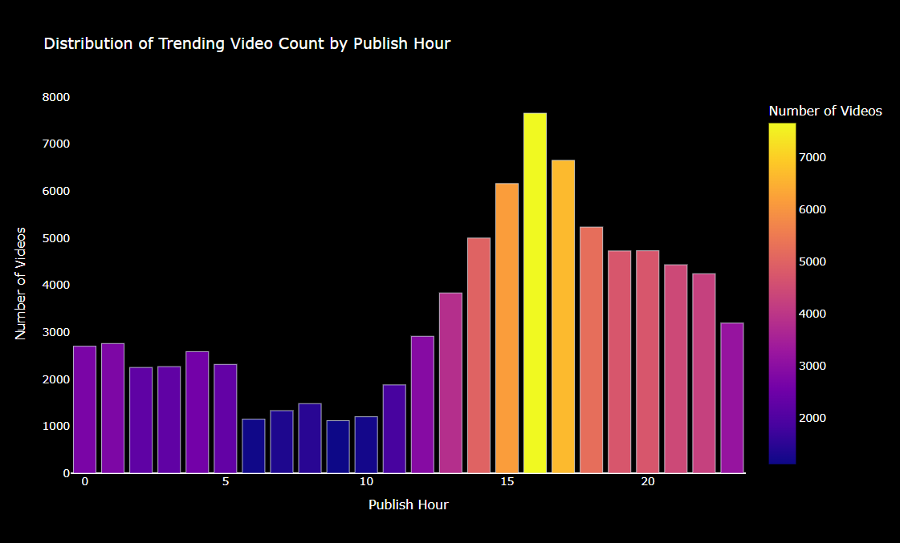
What is the best time to publish a video?
Country
Video Id,
Trending Date
Publish Time
------------
------------
------------
------------
------------

Slide 5
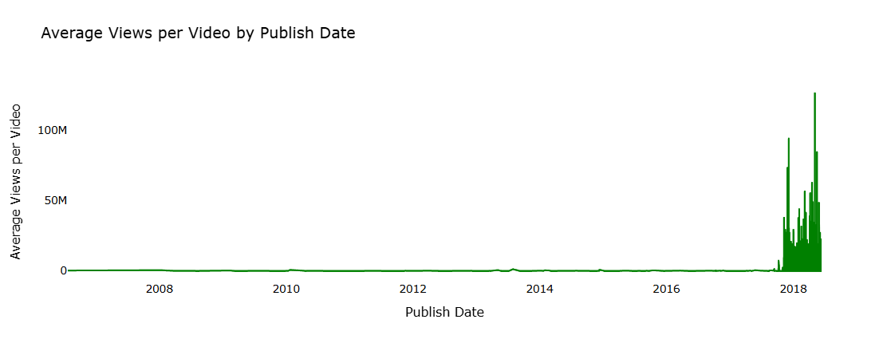
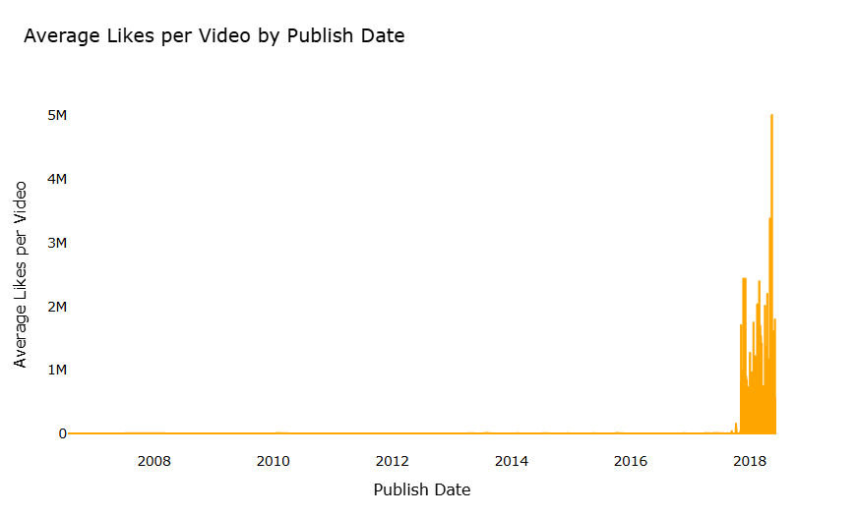
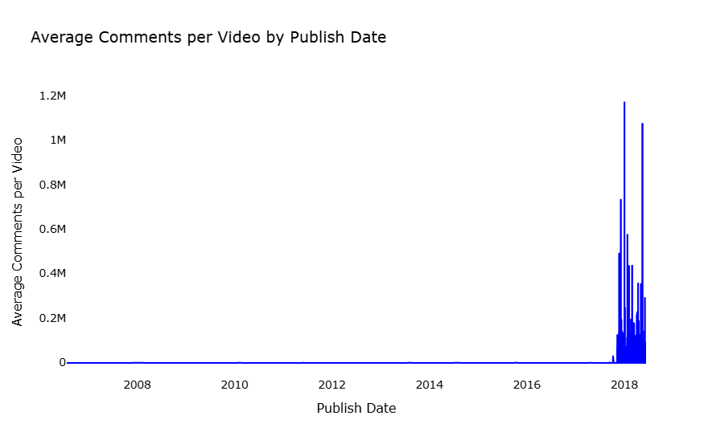
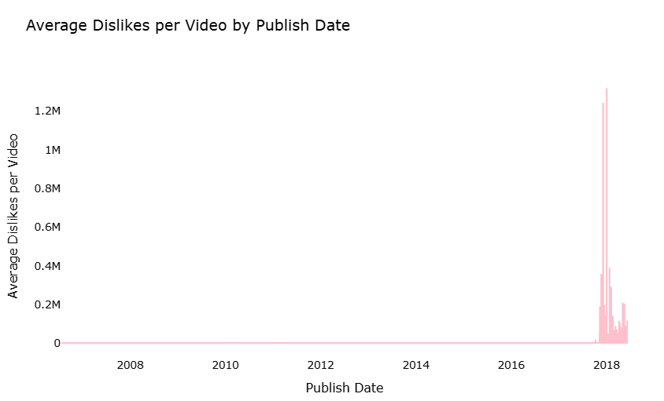
143B Views!
Country
1
4
3
5
6
3
7
4
5
2
2
1
Video Id,
Trending Date
Publish Time
View, Like, Dislike
& Comment
------------
143,563,745,221
Creator 3
------------
------------
------------

Slide 6
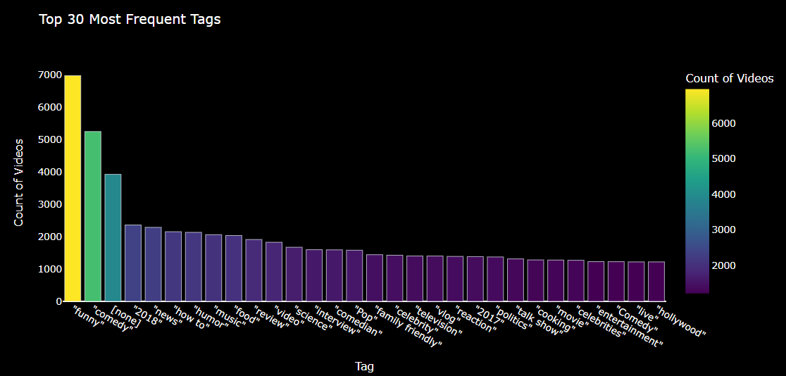
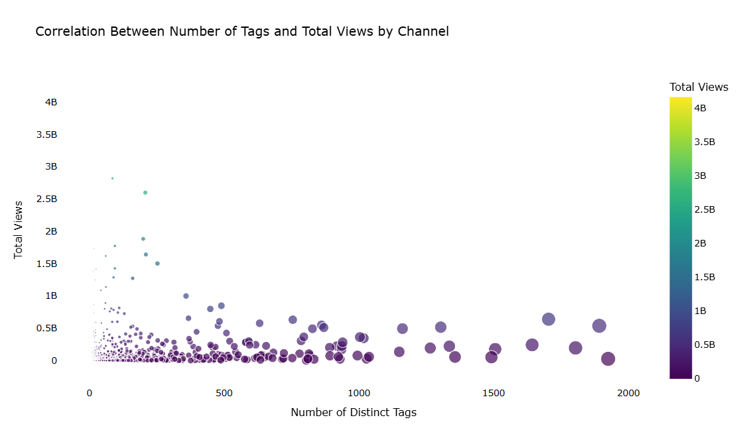
Country
Video Id,
Trending Date
Publish Time
View, Like, Dislike
& Comment
tags
------------
------------
------------

Slide 7
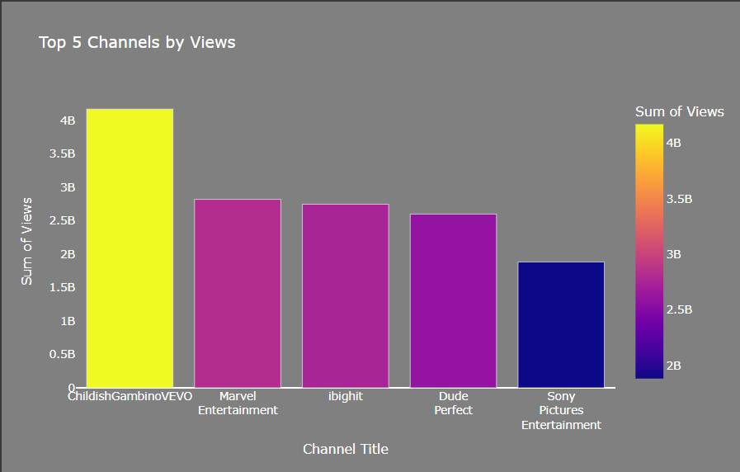
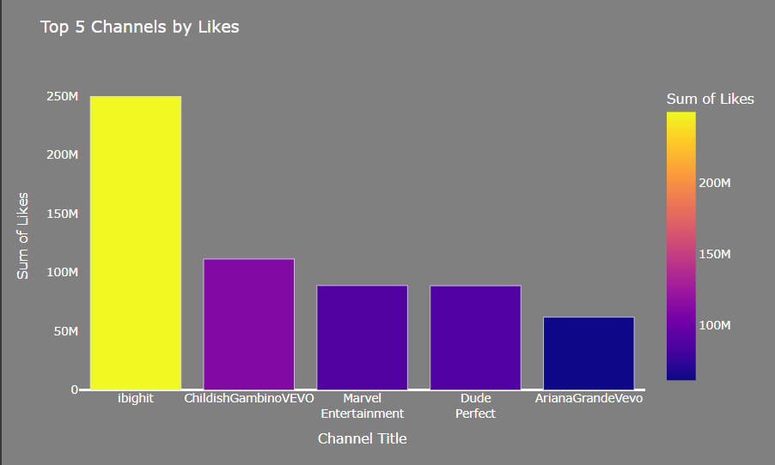
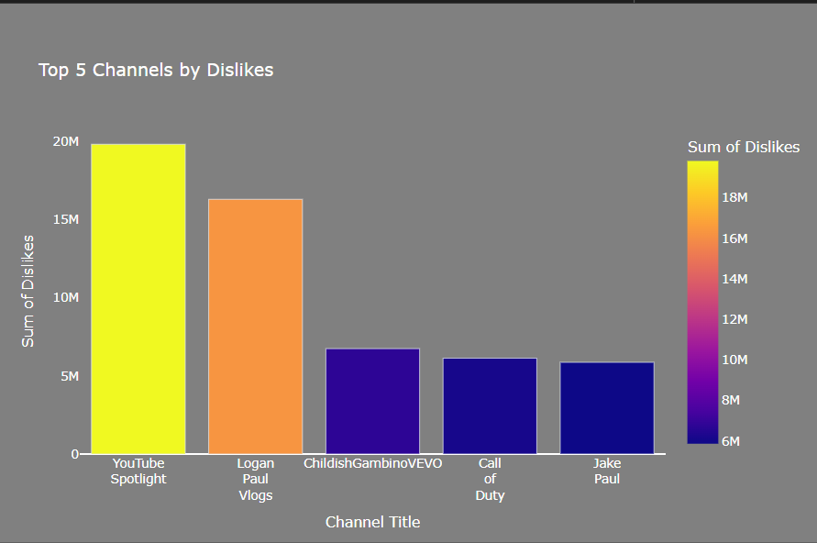
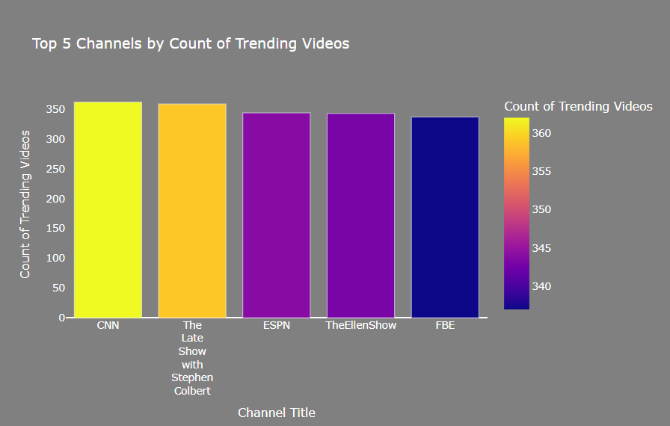
Country
Video Id,
Trending Date
Publish Time
View, Like, Dislike
& Comment
tags
Channel Title
------------
------------

Slide 8
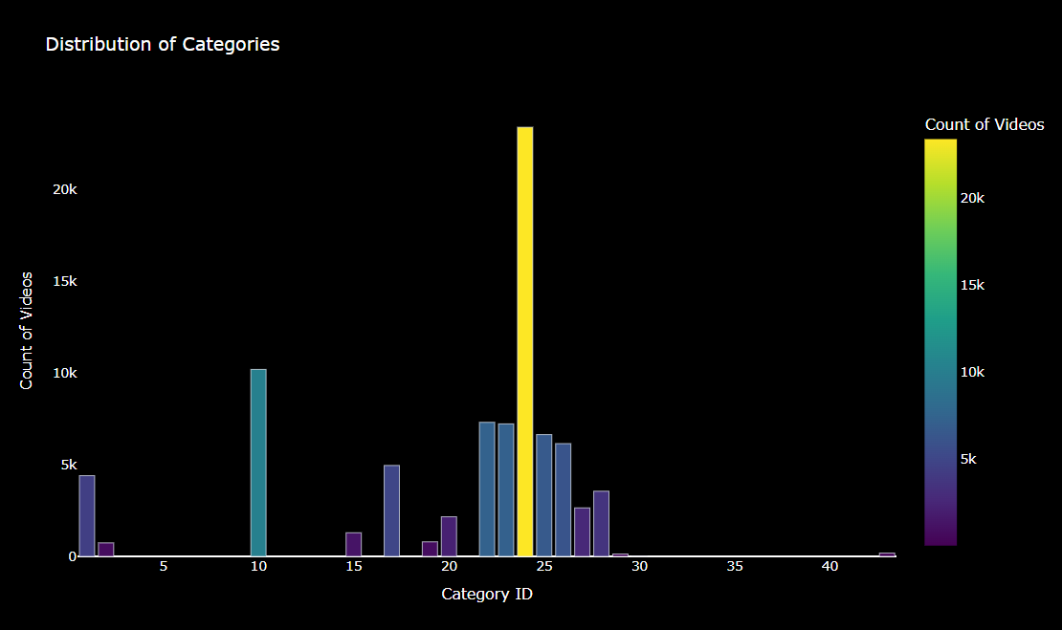
Country
Video Id,
Trending Date
Publish Time
View, Like, Dislike
& Comment
tags
Channel Title
Category Id
------------

Slide 9


📊 The Pipeline
All
Music
Gaming
Live
Lo-fi
Accept train or test mode as input.
In train mode:
Load and merge raw YouTube data.
Perform feature engineering (e.g., tag parsing, time extraction).
Preprocess data (cleaning, encoding, normalization).
Split data into training and validation sets.
Train classification model to categorize videos.
In test mode:
Load trained model and prepare test data.
Make predictions on new/unseen videos.
Pipeline of trending YouTube video categorization
UT
Subscribe
Share
Save
Data Science

Slide 10

Feature
Engineering
Focused on key numeric attributes for modeling:
Views
Likes
Dislikes
Publish Hour
Comment Count
Engagement Rate
Like Dislike Ratio
Tag Count
Data Cleaning:
1- Dropped unhelpful binary columns:
Comments Disabled
Ratings Disabled
Video Error Or Removed
2- Removed duplicates to avoid model bias or data leakage.
Normalization & Standardization:
Log Transformation
MinMaxScaler
StandardScaler
Feature Reduction:
Dropped like and dislike columns after deriving more meaningful features of them
Text Embedding Replacement
New Feature Creation
Categorical Encoding
Date Parsing
Boolean Conversion
Next: Preprocess

Slide 11
Model Result
3-Branch MLP
It is a deep learning model that classifies YouTube videos by combining text embeddings (from title, tags, and description) with numeric features like views and engagement metrics. Each input type is processed through separate dense layers, then merged and passed through fully connected layers to predict the video category. This design captures both semantic and quantitative patterns for accurate classification.
78.9%
Accuracy
73.7%
Precision

Slide 12
Thanks

